Slide 1
BIOINFORMATICS PIPELINE PROJECT
IN-SILICO IDENTIFICATION AND FUNCTIONAL
CHARACTERIZATION OF A TARGET
GENE/PROTEIN USING SEQUENCE ANALYSIS AND
HOMOLOGY-BASED ANNOTATION

Slide 2
Biological Sequence Selection
Go to NCBI
Search for a hypothetical protein sequence
Download its FASTA format
Open the file from downloads
Shift the file to bio python folder

Slide 3
Sequence Quality & Basic Analysis
The downloaded FASTA file is then imported to vs code
performed basic sequence quality analysis such as its id , description and length of the sequence

Slide 4
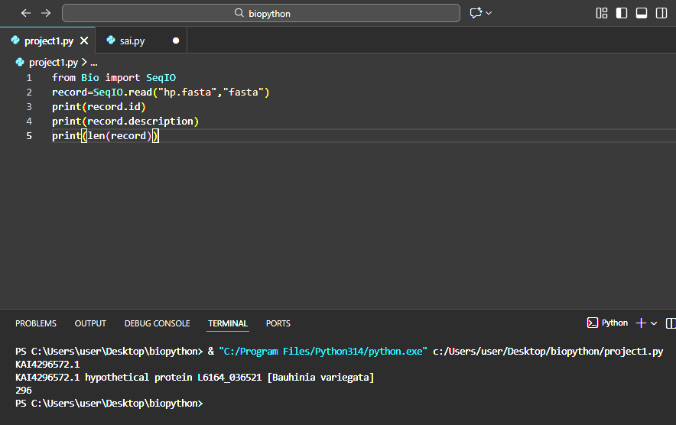

Slide 5
Sequence Filtering & Validation
The sequence selected is valid to perform further downstream analysis
The length of the unknown query protein sequence is 296 amino acids
The length is not too short or too long so that it is preferable for analysis

Slide 6
Homology Search
Blast is performed for query sequence using NCBI to search for similar homologous sequences
blast is operated using NCBIWWW module from bio python library via internet
Blast is successfully performed and a blast file named Blast_result.Xml

Slide 7
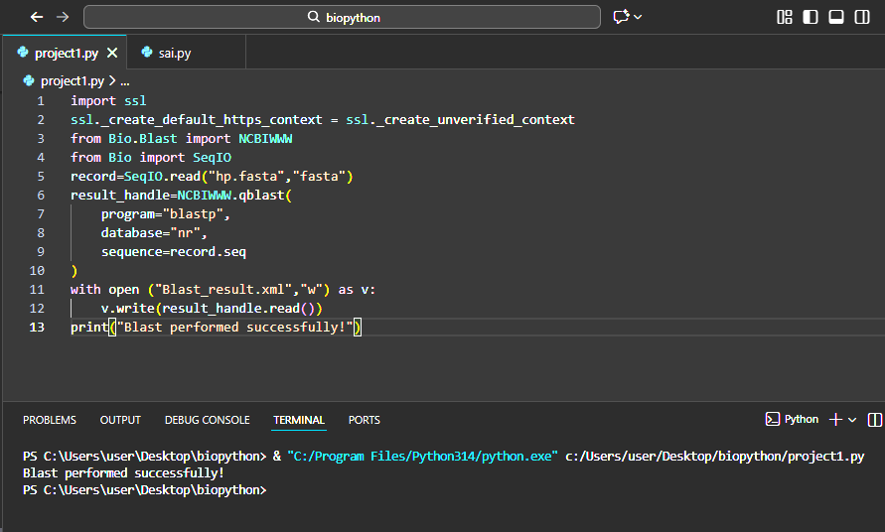

Slide 8
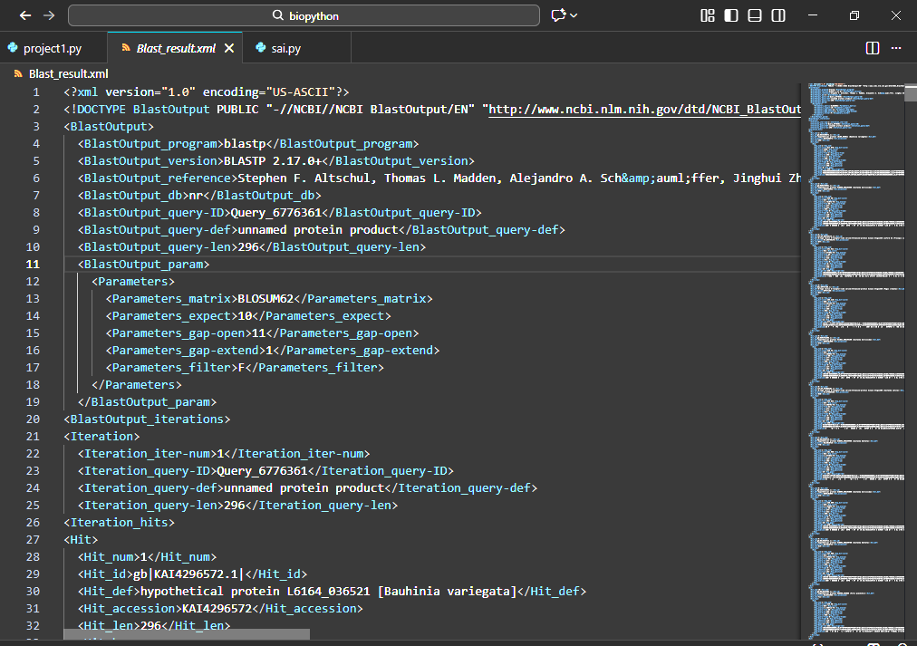

Slide 9
Functional Annotation
By reading Blast file , top highly matched sequences are printed in the output
A total of 50 alignments are obtained
The first alignment obtained is the highly matched sequence with the query sequence
The length , score and expect of first alignment is printed in the output
The alignment sequence printed in the output indicates the match with the query sequence

Slide 10
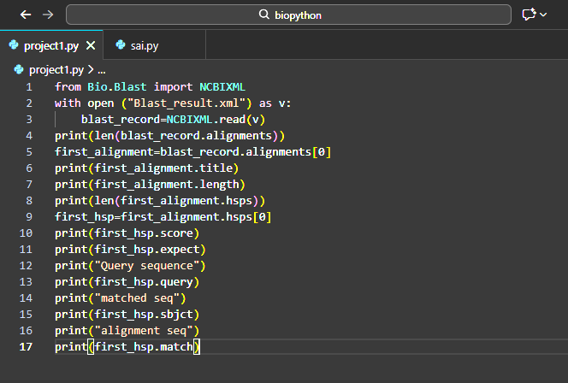

Slide 11
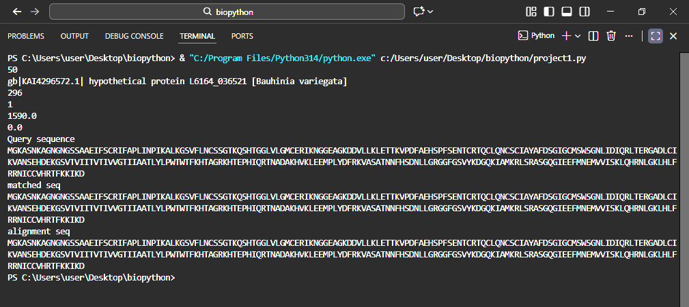

Slide 12
Biological Interpretation
Query sequency performs some functions such as Stress response and environmental signaling , Defence against pathogens and Signal transduction at the cell surface .
The function of query sequence is predicted using the matched sequence function as they both are homologous to each other
The alignment sequence printed in the output itself acts as the evidence that supports their claim since the alignment sequence represents the similarity in matched sequence and query sequence

Slide 13
conclusion
“I analyzed an unknown biological sequence, validated its quality, identified homologous sequences, and predicted its biological function using computational methods”.

